Slide 1
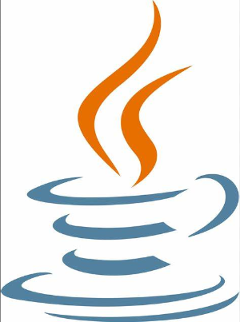

“CHAT APPLICATION USING JAVA”
Maanak Gadia(20BEC060)
Maurya Shah(20BEC065)
Under the guidance of
Dr. Sachin Gajjar
Department of Electronics and Communication Engineering,
Institute of Technology, Nirma University

Slide 2
ABSTRACT
Teleconferencing or chatting refers to any kind of communication that offers a real-time transmission of messages from sender to the receiver.
Analysis of chatting provides an overview of the technologies used, available features, functions, system of the architecture of the application, the structure of database of an Instant Messaging application: IChat(IC).
The objective of IC application is to facilitate text messaging, group chatting option, data transfer without size restriction which is commonly seen in most of the messaging applications.

Slide 3
OBJECTIVE
The aim of this project is to express how we can implement a simple chat application between a server and a client?
The application is a desktop based application and is implemented using Swing, AWT and socket programming. The project is developed in Java SE language executed on a single stand-alone java across a network using loop back address concept.
Application consists of two programs:
Server
Client

Slide 4
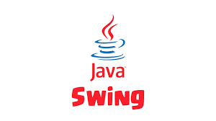
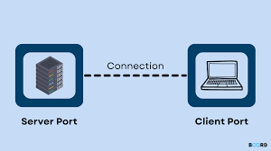
INTRODUCTION
Chatting Application is a desktop based application.
This client server chat application is based on java swing and socket package.
It is made up of 2 applications the client application, which runs on the user’s PC and server application, which runs on any PC on the network.
We will focus on TCP socket connections which are a fundamental part of socket programming.

Slide 5
PROJECT SCOPE
This project can be mainly divided into two modules:
Server :- The server module of the application waits for the client to connect to it. Then if connection is granted a client interacts, communicates and connects to the server, it can mutually communicate with the server. The duty of the server is to let clients exchange the messages.
Client :- The client module is the one that user sends requests to the server. User utilizes the client as the means to connect to the server. Once he establishes the connection, he can communicate to the connected server.

Slide 6
OPERATIONAL CONCEPT AND SCENARIO
Operation of the application based on the inputs given by the user:
When the run button is clicked then the chat form is initialized with a connection between the host and the client machine.
Note: server must be started at first before a client start.
Contains a rich textbox which send messages from one user to another
Contains a textbox for messages to be written that is sent across the network.
Contains a Send button.
When the send button is clicked, in the background, the text in the textbox is encoded
And sent as a packet over the network to the client machine. Here this message is decoded and is shown in the rich textbox.

Slide 7
CODE EXPLAINATION
SERVER:
The code begins with necessary imports, including Swing for the GUI and networking classes for socket programming.
It initializes the Server class for the server side. The GUI setup includes input fields, buttons, and labels.
User actions are handled through the actionPerformed method, focusing on message sending.
The formatLabel method formats messages with timestamps.
The main method starts the server, listens for client connections, and displays received messages in the GUI. This code forms the server's core.
CLIENT:
The client code closely parallels the server component. It begins with importing necessary classes
and libraries.
The Client class is then initialized to create the client side of the chat application, with a GUI for user input.
User actions, particularly message sending, are managed by the actionPerformed method.
Messages are formatted using the formatLabel method.
The main method initializes the client, connects it to the server, and continuously displays received messages in the client's GUI. This code embodies the core client-side functionality.

Slide 8
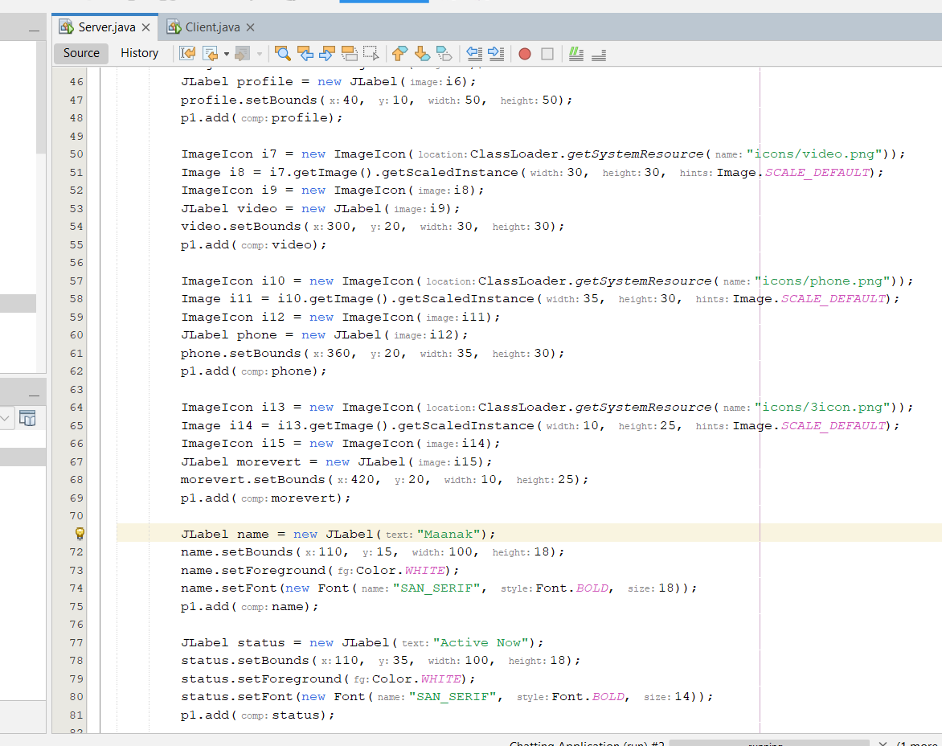
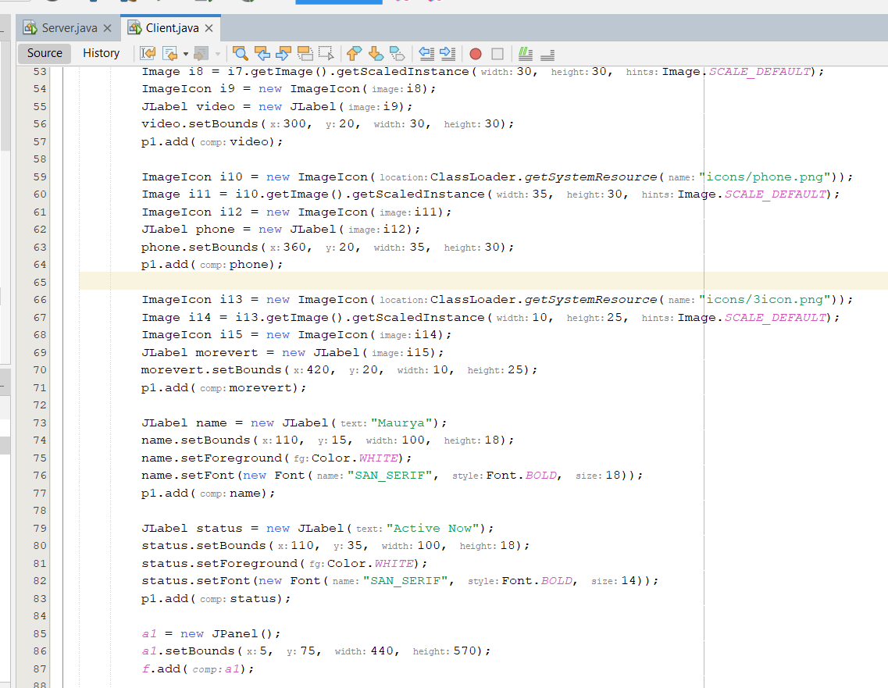

Slide 9
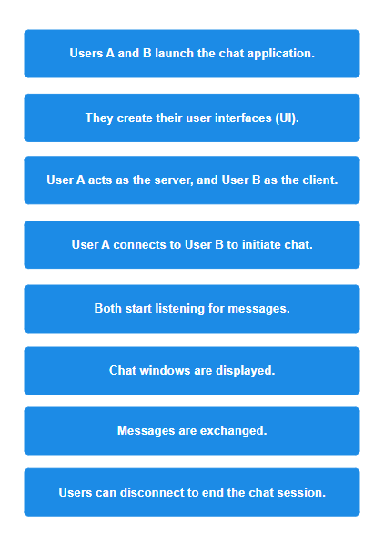
FLOW

Slide 10
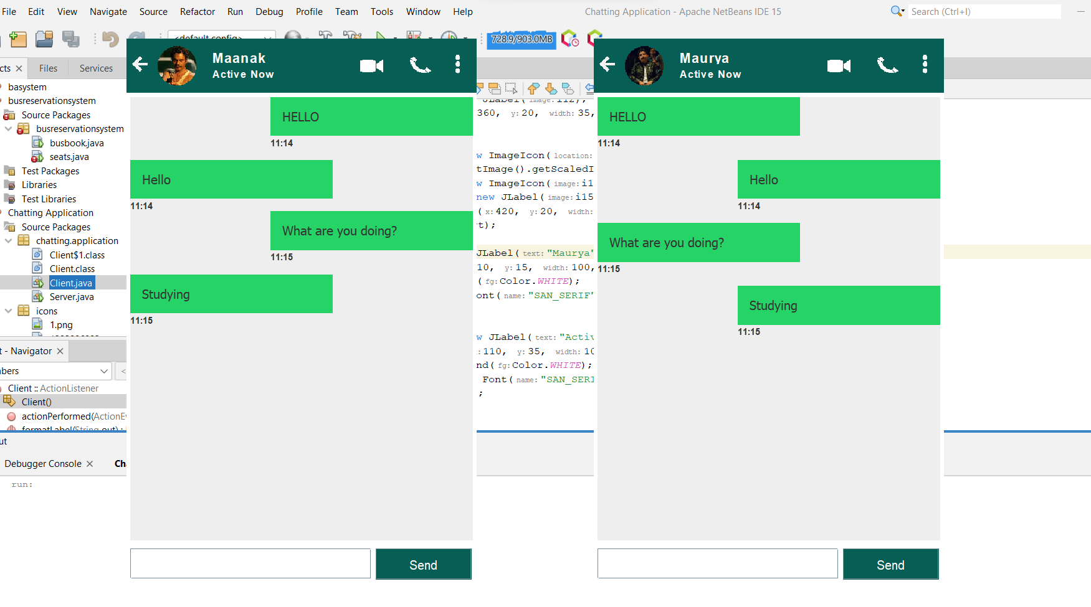
RESULT

Slide 11
CONCLUSION
We developed network applications in Java by using sockets, threads, and Web services. This software is portable, efficient, and easily maintainable for large number of clients. Our developed web-based chatting software is unique in its features and more importantly easily customizable. The java.net package provides a powerful and flexible set of classes for implementing network applications. Typically, programs running on client machines make requests to programs on a server Machine. These involve networking services provided by the transport layer. The most widely used transport protocols on the Internet are TCP (Transmission control Protocol) and UDP (User Datagram Protocol). TCP is a connection-oriented protocol providing a reliable flow of data between two computers. On the other hand, UDP is a simpler message-based connectionless protocol which sends packets of data known as datagrams from one computer to another with no guarantees of arrival.

Slide 12
FUTURE SCOPE
There is always a room for improvements in any software package, however good and efficient it may be done. But the most important thing should be flexible to accept further modification.
Right now we are just dealing with text communication. In future this software may be extended to include features such as:
Files transfer
Voice chat
Video chat

Slide 13
REFERENCES
https://docs.oracle.com/en/java/
https://www.javatpoint.com/java-swing
https://www.geeksforgeeks.org/a-group-chat-application-in-java/
https://www.geeksforgeeks.org/socket-programming- cc/:text=What%20is%20socket%20programming%3F,other%20to%

